Slide 1
EMTH403
Mathematical Foundation for Computer Science

Slide 2
Lecture Outcomes
understand what are Planar Graphs
understand what is Euler’s Formulae and how K_{3,3} is a non-planar Graph.

Slide 3
Theorem 1 (Kuratowski, 1930)
A graph is planar if and only if it does not contain a subgraph that is a K₅ or K_{3,3} configuration.

Slide 4
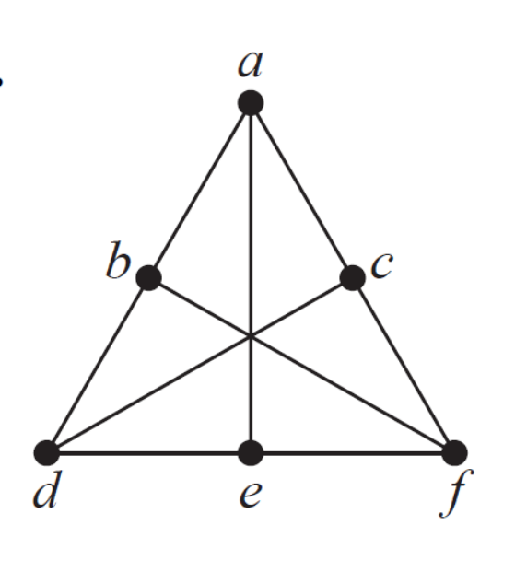
Planar Graphs
Determine whether the given graph is planar. If so, draw it so that no edges cross.
This is K _{3 ,3} , with parts {a, d, f} and {b, c, e}. Therefore it is not planar.
K_{3,3}

Slide 5
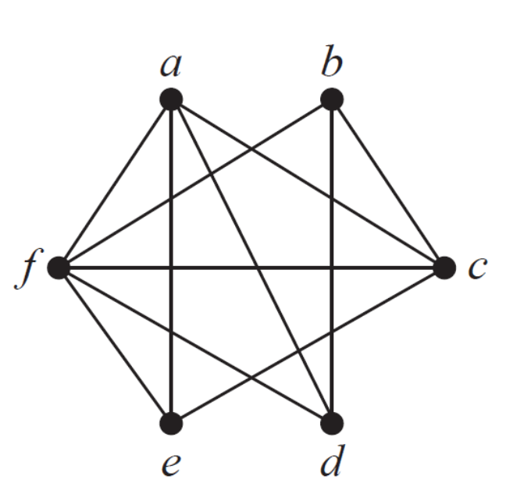
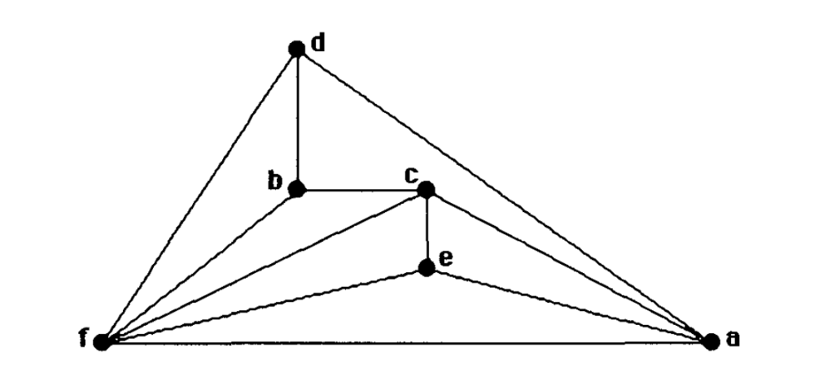
Planar Graphs
Ques:- Determine whether the given graph is planar. If so, draw it so that no edges cross.
Sol:- This graph can be untangled if we play with it long enough. The following picture gives a planar representation of it.

Slide 6
Euler’s Formula
Euler devised a formula for expressing the relationship between the number of vertices, edges, and regions of a planar graph.
These may help us determine if a graph can be planar or not.

Slide 7
Euler’s Formula
Let G be a connected planar simple graph with e edges and v vertices. Let r be the number of regions in a planar representation of G. Then r = e - v + 2.
Or 2 = v– e + r.
R₄ R₃ R₂
R₁
# of edges, e = 6
# of vertices, v = 4
# of regions, r = e - v + 2 = 4

Slide 8
Euler’s Formula
Euler characteristic (simple form):
2 = number of vertices – number of edges + number of faces
Or in short-hand,
2 = |V| - |E| + |F|
where V = set of vertices
E = set of edges
F = set of faces = set of regions
For a planar connected graph |V| - |E| + |F| = 2

Slide 9
Euler’s Formula
Def^{n}: A tree is a connected graph that does not contain a cycle.
A forest is a graph whose components are trees.
Lemma 2.1: Any tree with n vertices has n-1 edges.

Slide 10
Euler’s Formula
2= |V| – |E| + |F|
= 1 – 0 + 1 = 2

Slide 11
Euler’s Formula
2= |V| – |E| + |F|
= 2 – 1 + 1 = 2

Slide 12
Euler’s Formula
2= |V| – |E| + |F|
= 3 – 2 + 1 = 2

Slide 13
Euler’s Formula
2= |V| – |E| + |F|
= 4 – 3 + 1 = 2

Slide 14
Euler’s Formula
2= |V| – |E| + |F|
= 5 – 4 + 1 = 2

Slide 15
Euler’s Formula
2= |V| – |E| + |F|
= 8 – 7 + 1 = 2

Slide 16
Euler’s Formula
2= |V| – |E| + |F|
= 8 – 8 + 2 = 2
Not a tree.

Slide 17
Euler’s Formula
2= |V| – |E| + |F|
= 8 – 8 + 2 = 2
Not a tree.

Slide 18
Euler’s Formula
2= |V| – |E| + |F|
= 8 – 9 + 3 = 2
Not a tree.

Slide 19
Euler’s Formula
Ques:- Suppose that a connected planar graph has six vertices, each of degree four. Into how many regions is the plane divided by a planar representation of this graph?
Sol:- By Euler's formula r = e - v + 2. Given v = 6.
Given that each vertex has degree 4,
Then sum of the degrees is 6*4=24.
By the handshaking theorem there are e= 24/2=12 edges
Solving r=12-6+2 =6+2, r = 8.
Answer: c(8).

Slide 20
Euler’s Formula
Ques:- How many regions would be in a plane graph with 10 vertices each of degree 3?
Sol:- By Euler's formula r = e - v + 2. Given v = 10.
Given that each vertex has degree 4,
Then sum of the degrees is 10*3=30.
By the handshaking theorem there are e= 30/2=15 edges
Solving r=15-10+2 =5+2, r = 7.
Answer: c(7).

